Slide 1
Software Engineering
Topic 7: System Dependency and Security
Notes:
NCC Education - Title Master

Slide 2
The Unit Roadmap
Topic 1: Introduction
Topic 2: Introduction to Software Engineering Key Practices and Principles
Topic 3: Software Development Life Cycle Models
Topic 4: Requirement Engineering
Topic 5: System Modelling & Design
Topic 6: Software Implementation & Testing
Topic 7: System Dependency & Security
Topic 8: Project Management
Topic 9: Mini Project 1
Topic 10: Mini Project 2
Topic 11: Mini Project 3
Topic 12: Mini Project 4

Slide 3
Recap on Topic 6
When developing software, you should always consider the possibility of reusing existing software. What are levels of software reuse?
Most software development is host-target development. Which tool is used on a host machine to develop the software and what the name stands for?
Development testing is the responsibility of the software development team. What are different types of software testing?
What is the approach to acceptance testing in agile software development?

Slide 4
Learning Outcomes
By the end of this topic students will be able to:
Describe methods for ensuring software quality.
Discuss approaches to Secure Software Engineering

Slide 5
Scope and Coverage
This topic will cover:
Security defined: dependable systems
Reliability engineering: availability and reliability, fault tolerance
Safety Engineering: safety critical systems, formal specifications
Notes:
NCC Education - Slide Master

Slide 6
System Dependability
For many systems, the most important property is the dependability of the system.
The dependability reflects the user’s degree of trust in that system. It reflects the extent of the user’s confidence that it will operate as users expect and that it will not ‘fail’ in normal use.
Dependability covers the related systems attributes of reliability, availability and security. These are all inter- dependent.

Slide 7
Importance Of Dependability
System failures may have widespread effects with large numbers of people affected by the failure.
Systems not dependable are unreliable, unsafe or insecure may be rejected by their users.
Costs of system failure may be very high if the failure leads to economic losses or physical damage.
Undependable systems may cause information loss with a high consequent recovery cost.

Slide 8
Causes Of Failure
Hardware failure
Hardware fails because of design and manufacturing errors or because components have reached the end of their natural life.
Software failure
Software fails due to errors in its specification, design or implementation.
Operational failure
Human operators make mistakes. Now perhaps the largest single cause of system failures in socio-technical systems.

Slide 9



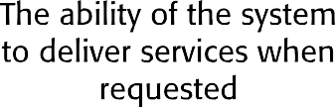
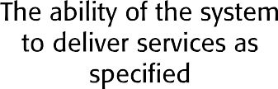
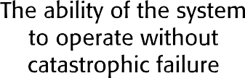
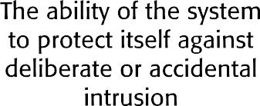
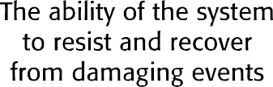
The Principal Dependability Properties
Sommerville, I. (2016)

Slide 10
Principal Properties
Availability
The probability that the system will be up and running and able to deliver useful services to users.
Reliability
The probability that the system will correctly deliver services as expected by users.
Safety
A judgment of how likely it is that the system will cause damage to people or its environment.

Slide 11
Principal Properties
Security
A judgment of how likely it is that the system can resist accidental or deliberate intrusions.
Resilience
A judgment of how well a system can maintain the continuity of its critical services in the presence of disruptive events such as equipment failure and cyberattacks.

Slide 12
Other Dependability Properties
Repairability
Reflects the extent to which the system can be repaired in the event of a failure.
Maintainability
Reflects the extent to which the system can be adapted to new requirements.
Error tolerance
Reflects the extent to which user input errors can be avoided and tolerated.

Slide 13
Short Activity
In your opinion, the dependency properties discussed in earlier slides are considered as functional or non-functional requirements of system?
Justify your answers

Slide 14
Systems And Software
Software engineering is not an isolated activity but is part of a broader systems engineering process.
Software systems are therefore not isolated systems but are essential components of broader systems that have a human, social or organisational purpose.
Example:
A weather system is part of broader weather recording and forecasting systems.
These include hardware and software, forecasting processes, system users, the organisations that depend on weather forecasts, etc.

Slide 15















The Sociotechnical Systems Stack
Sommerville, I. (2016)

Slide 16
Regulation And Compliance
The general model of economic organisation that is now almost universal in the world is that privately owned companies offer goods and services and make a profit.
To ensure the safety of their citizens, most governments regulate (limit the freedom of) privately owned companies so that they must follow certain standards to ensure that their products are safe and secure.

Slide 17
Short Activity
Do you know any laws, regulation or standards that regulate security or privacy attributes of software?

Slide 18
Dependable Processes
To ensure a minimal number of software faults, it is important to have a well-defined, repeatable software process.
A well-defined repeatable process is one that does not depend entirely on individual skills; rather can be enacted by different people.
Regulators use information about the process to check if good software engineering practice has been used.
For fault detection, it is clear that the process activities should include significant effort devoted to verification and validation.

Slide 19
Dependable Process Characteristics
Explicitly defined
A process that has a defined process model that is used to drive the software production process. Data must be collected during the process that proves that the development team has followed the process as defined in the process model.
Repeatable
A process that does not rely on individual interpretation and judgment. The process can be repeated across projects and with different team members, irrespective of who is involved in the development.

Slide 20
Attributes Of Dependable Processes
Process Characteristic | Description
Auditable | Understandable by people apart from process participants, who can check that process standards are being followed and make suggestions for process improvement.
Diverse | Include redundant and diverse verification and validation activities.
Documentable | A defined process model that sets out the activities in the process and the documentation that is to be produced during these activities.
Robust | Able to recover from failures of individual process activities.
Standardised | A comprehensive set of software development standards covering software production and documentation should be available.
Sommerville, I. (2016)

Slide 21
Dependable Process Activities
Requirements reviews to check that the requirements are, as far as possible, complete and consistent.
Requirements management to ensure that changes to the requirements are controlled and that the impact of proposed requirements changes is understood.
Formal specification, where a mathematical model of the software is created and analyzed.
System modeling, where the software design is explicitly documented as a set of graphical models, and the links between the requirements and these models are documented.

Slide 22
Dependable Process Activities
Design and program inspections, where the different descriptions of the system are inspected and checked by different people.
Static analysis, where automated checks are carried out on the source code of the program.
Test planning and management, where a comprehensive set of system tests is designed.
The testing process has to be carefully managed to demonstrate that these tests provide coverage of the system requirements and have been correctly applied in the testing process.

Slide 23
Dependable Processes And Agility
Dependable software often requires certification so both process and product documentation must be produced.
Up-front requirements analysis is also essential to discover requirements and requirements conflicts that may compromise the safety and security of the system.
These conflict with the general approach in agile development of co-development of the requirements and the system and minimising documentation.

Slide 24
Dependable Processes And Agility
An agile process may be defined that incorporates techniques such as iterative development, test-first development and user involvement in the development team.
So long as the team follows that process and documents their actions, agile methods can be used.
However, additional documentation and planning is essential so ‘pure agile’ is impractical for dependable systems engineering.

Slide 25
Safety Critical Systems
Safety-critical systems are those systems whose failure or malfunction could result in significant harm to people, property, or the environment.
These systems are designed, operated, and maintained with a focus on ensuring their
Reliability
Availability
safety.
Examples of safety-critical systems include:
Transportation systems
Medical devices
Nuclear power plants
Industrial control systems
Aerospace systems
Defence systems

Slide 26
Developing Safety Critical Systems
Developing safety-critical systems involves careful consideration of various factors to ensure their reliability, robustness, and safety.
Some of the key factors that need to be considered include:
Clearly defining safety requirements early in the development process
Conducting thorough risk analysis to identify and control potential hazards
Compliance with relevant safety standards, regulations, and industry best practices
Designing systems with built-in redundancy, error detection, and fault tolerance mechanisms
Rigorous testing, verification, and validation processes
Considering human factors such as user interface design, training requirements, and human error prevention
Implementing effective lifecycle management processes, including configuration management, maintenance, and updates
Establishing mechanisms for continuous monitoring, feedback, and learning from operational experience

Slide 27
Short Activity
Can you relate the discussion in previous slide around secure development of critical system to the type of SDLC model more appropriate to the development of these systems? (a reminder on the lecture on SDLC models)

Slide 28
Formal Specification
Approaches to software development that are based on mathematical representation and analysis of software.
Formal methods include:
Formal specification;
Specification analysis and proof;
Transformational development;
Program verification.
Significantly reduce some types of programming errors and can be cost-effective for dependable systems engineering.
Very expensive to implement, limited applicability

Slide 29
Formal Approaches
Verification/validation-based approaches
Formal methods provide systematic techniques for verifying and validating software designs and implementations against specified requirements.
Formal verification involves proving that a system meets its specification, while formal validation involves confirming that the system satisfies user needs and expectations.
This demonstrates the absence of implementation errors.
Refinement-based approaches
A representation of a system is systematically transformed into another, lower-level representation e.g. a specification is transformed automatically into an implementation.

Slide 30
Use Of Formal Methods
The principal benefits of formal methods are in reducing the number of faults in systems.
Consequently, their main area of applicability is in dependable systems engineering. There have been several successful projects where formal methods have been used in this area.
In this area, the use of formal methods is most likely to be cost-effective because high system failure costs must be avoided.

Slide 31
Classes Of Error
Specification and design errors and omissions.
Developing and analysing a formal model of the software may reveal errors and omissions in the software requirements. If the model is generated automatically or systematically from source code, analysis using model checking can find undesirable states that may occur such as deadlock in a concurrent system.
Inconsistences between a specification and a program.
If a refinement method is used, mistakes made by developers that make the software inconsistent with the specification are avoided. Program proving discovers inconsistencies between a program and its specification.

Slide 32
Short Activity
Do research to identify the most common errors in the software development process.

Slide 33
Checkpoint Summary
System Dependability covers the related systems attributes of reliability, availability, safety, resilience and security.
To ensure the safety of their citizens, most governments regulate (limit the freedom of) privately owned companies so that they must follow certain standards to ensure that their products are safe and secure.
Dependable software often requires certification so both process and product documentation must be produced.
Developing safety-critical systems involves careful consideration of various factors to ensure their reliability, robustness, and safety.
Formal specification is an approach to software development that is based on mathematical representation and analysis of software.

Slide 34

Secure System Development Principles
The 5 key practices for more secure software:
Good design
Security Testing
Dependency checking
Protect your Source Code
Education
Notes:
This slide is presenting secure software development best practices during the SDLC. This is better illustrated in slide 36.

Slide 35
slower
Software Security Testing
more
expensive
Pen Tests
Integration Security Tests
Static Application Security Tests
cheaper
Unit Tests
faster
Notes:
There are different types of tests for software code security testing including a normal unit test, a code static testing and as a more sophisticated test, a penetration testing after the application development. However, each test comes with its proms and cons. While a unit test during the development cycle is cheaper and faster, it might not find security bugs of an integrated system. In contrast, static test is a test during development but before deployment and run the whole code without running it. Pen test is tehnmost expensive and slowest test among these 3 tests. But it can identify most code vulnerabilities of the integrated software.

Slide 36
✓
Security Unit Testing
Write Security Unit Test Cases:
Identity, Authentication & Access Control
Input Validation & Encoding
Encryption
User and Session Management
Error and Exception Handling
Auditing and Logging
✓
✓
✓
✓
✓
✗
✓
Notes:
To write security unit test we should write them in a way to validate the security mechanisms implemented in the code. Each test case should focus on a specific security aspect or scenario and verify that the code behaves as expected. Below are some cases focusing on security requirements:
Test input validation: Verify that input validation mechanisms correctly reject invalid or malicious inputs and prevent common security vulnerabilities, such as injection attacks and XSS.
Test authentication and authorization: Validate that authentication and authorization mechanisms correctly enforce access control policies and prevent unauthorized access to sensitive resources.
Test encryption and data protection: Verify that encryption mechanisms are correctly implemented and protect sensitive data from unauthorized access or tampering.
Test error handling: Validate that error handling mechanisms handle security-related errors gracefully and do not reveal sensitive information to attackers.
Test logging and auditing: Ensure that logging and auditing mechanisms capture relevant security events and activities for monitoring and analysis purposes.

Slide 37
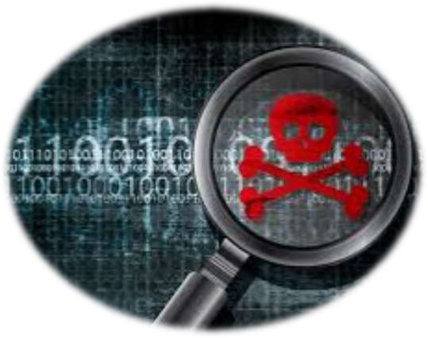
Use Static Code Analysis Tools
Code Security Testing
Integrate into IDE / CI/CD Pipeline
Identifies Most Common Source Code Vulnerabilities
Scans Source Code or Binaries
Top SAST Tools Include:
Checkmarx
Veracode
Fortify on Demand
SonarQube
HCL AppScan
BUT…
Can Generate Many False Positives
Bound to Specific Technologies

Slide 38

Use Penetration Testers Exploit Vulnerabilities in your Code
Penetration Testing
They use complex chains of vulnerabilities not Identified by Automated Tests
Imitate Hackers and use Hacker Tools
Provide a Report of Vulnerabilities
BUT…
Do NOT rely EXCLUSIVELY on Pen Testing
Usually Performed TOO LATE in the SDLC for developers

Slide 39
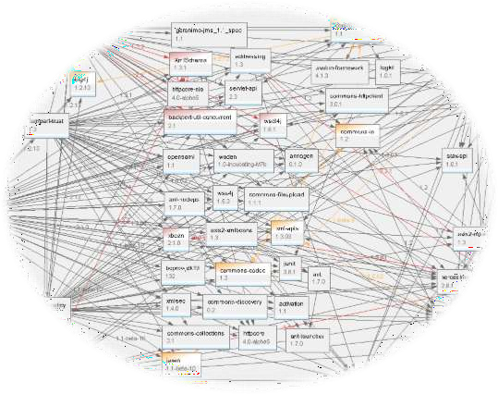
Check that your Free Open-Source Software are not Vulnerable to Security bugs and holes
Open Source Security
Use Scanning Tools to Scan your Dependencies
Known Vulnerabilities are Exploited by Hackers
CVEs are Publicly Available (mitre.org)
Patch!!!
Use Scanning Tools Directly in your IDE –
UPDATE LIBS QUICKLY in DEV
SCAN CONTAINERS – they bring a whole bunch of vulnerabilities with them!!!!
Notes:
CVE stands for: Common Vulnerabilities and Exposures.
Mitre.org is a recourse for threat modelling. MITRE is a threat modelling approach. Threat modelling is discussed in slide 37.

Slide 40
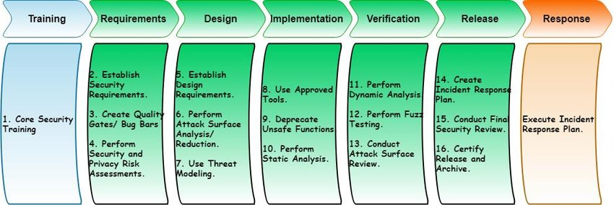





Security Mechanisms in SDLC
Herath, H.M.R.P. and Wimalaratne, G. (2018)

Slide 41
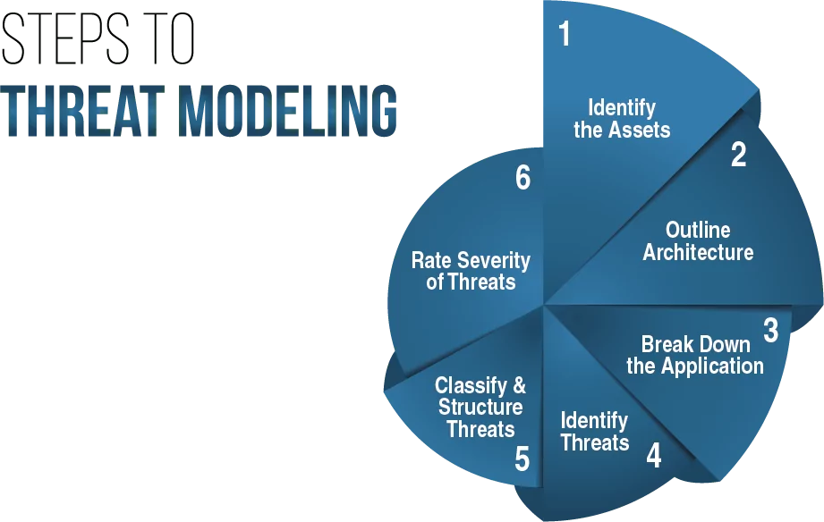
Threat Modelling
A systematic approach to identify, quantify and address threats
It is an essential part of SDLC (in Design stage)
https://www.eccouncil.org/threat-modeling/

Slide 42
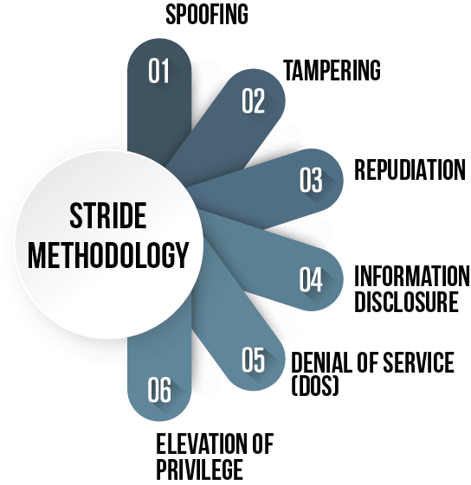
STRIDE
STRIDE is a mnemonic used in threat modelling to categorize different types of threats.
It helps identify potential security vulnerabilities and design appropriate countermeasures to mitigate them.
https://www.eccouncil.org/threat-modeling/

Slide 43
Checkpoint Summary
The dependability of a system reflects the user’s degree of trust in that system
Dependency has number of attributes including availability, security, reliability, resilient and safety.
Dependable process are set of procedures and activities in SDLC to ensure software does not fail.
Formal methods are approaches to software development that are based on mathematical representation and analysis of software.
Along with formal methods to ensure software equality there are practices to ensure security quality of software.

Slide 44
Quiz
True or False:
The ability of a system to deliver services when required is called availability.
Static analysis is a type of formal method in which the program code is audited.
Fill the gap:
A judgment of how likely it is that the system can resist accidental or deliberate intrusions is called --------------.
System security testers can write unit testing for security elements such as --------- and -----------.
Using Hacker Tools to imitate hackers is called ----------

Slide 45
Private Study
Identify differences between dynamic and static code security analysis.
List and explain the tools for each of these two security testing.

Slide 46
The Unit Roadmap
Topic 1: Introduction
Topic 2: Introduction to Software Engineering Key Practices and Principles
Topic 3: Software Development Life Cycle Models
Topic 4: Requirement Engineering
Topic 5: System Modelling & Design
Topic 6: Software Implementation & Testing
Topic 7: System Dependency and Security
Topic 8: Project Management
Topic 9: Mini Project 1
Topic 10: Mini Project 2
Topic 11: Mini Project 3
Topic 12: Mini Project 4

Slide 47
Next Session – Topic 8 Project Management
In Topic 8, you will learn:
Project Planning: Scheduling, Estimating, Gantt charts.
Risk assessment and management
Teamwork
Quality management
Change management

Slide 48
References
Herath, H.M.R.P. and Wimalaratne, G. (2018) 'A collaborative platform featuring visibility, tracking, monitoring and awareness for building security in.,' International Journal of Computer and Communication Engineering, 7(4), pp. 145–166. https://doi.org/10.17706/ijcce.2018.7.4.145-166.
Sommerville, I. (2016), Software Engineering, 10th edition, Pearson

Slide 49
Topic 7 – System Dependency and Security
Any Questions?
Notes:
NCC Education - End Slide Master

